Slide 1
How Do We Enable TinyML?

Slide 2

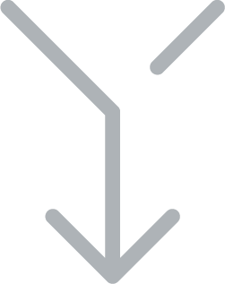

What Makes TinyML?
TinyML
Embedded
Systems
Machine
Learning
Notes:
https://thenounproject.com/term/puzzle/2102706/
https://thenounproject.com/search/?q=merge&i=2448469

Slide 3
What Makes TinyML?
TinyML
Embedded
Systems
Machine
Learning
Notes:
https://thenounproject.com/term/puzzle/2102706/

Slide 4
What Makes TinyML?
TinyML
Embedded
Systems
Machine
Learning
Notes:
https://thenounproject.com/term/puzzle/2102706/

Slide 5
Let’s Take an Example
Notes:
https://search.creativecommons.org/photos/79bb0e83-a3c4-435b-abb5-21bbb4377f43

Slide 6
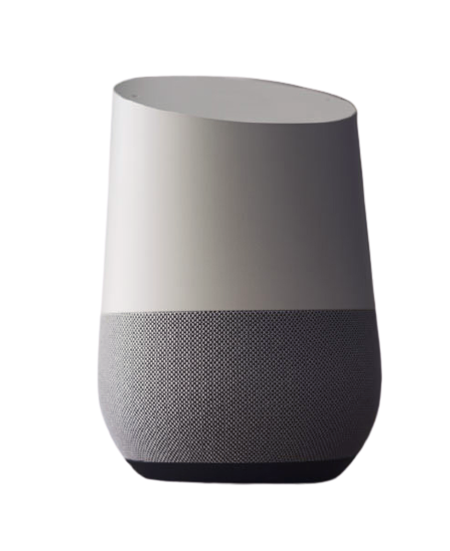

Let’s Take an Example
Google Assistant
Notes:
https://search.creativecommons.org/photos/79bb0e83-a3c4-435b-abb5-21bbb4377f43

Slide 7
Let’s Take an Example
Okay, Google!
Hi, how can I help?
Notes:
Ha, take that. I redrew it.

Slide 8




The Three Basic Steps
Notes:
https://thenounproject.com/search/?q=output&i=2386380
https://thenounproject.com/search/?q=input&i=2386437
https://thenounproject.com/search/?q=processing&i=3202979

Slide 9
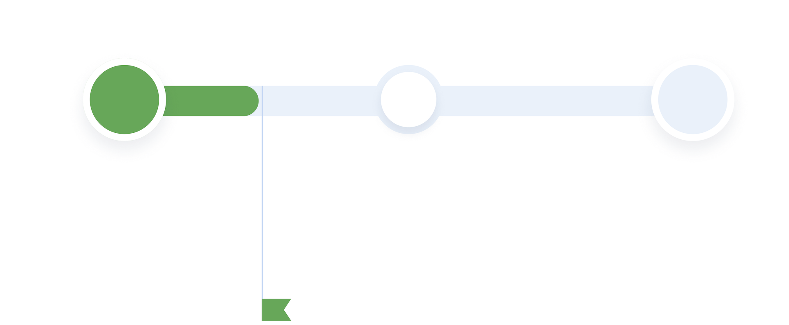
The Three Basic Steps
Step 1
Audio input
from microphone (sensor)
input
complete

Slide 10
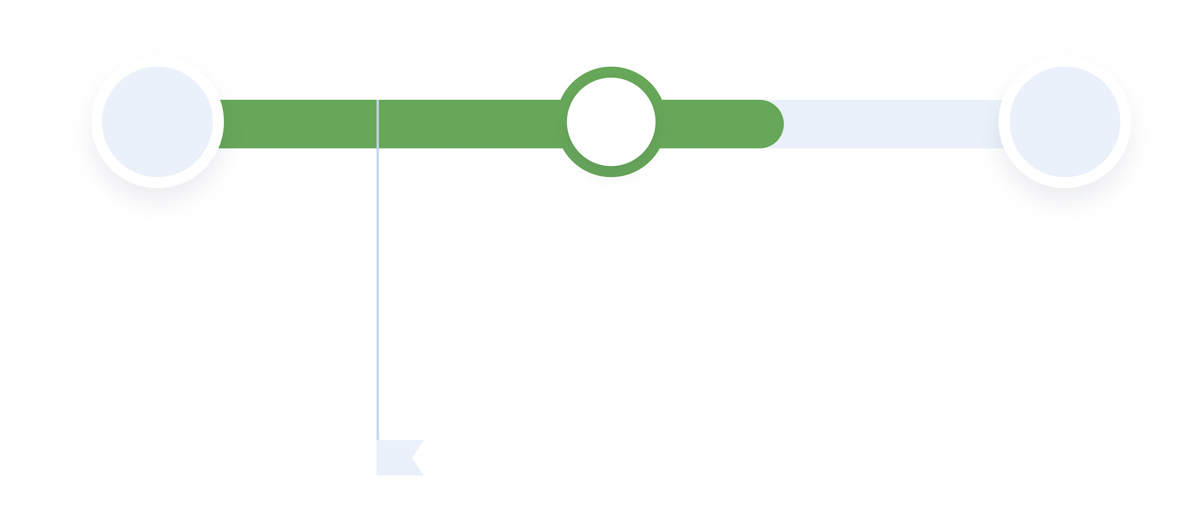

The Three Basic Steps
Step 1
Audio input
from microphone (sensor)
Step 2
Process input translation, then execute command
input
complete

Slide 11
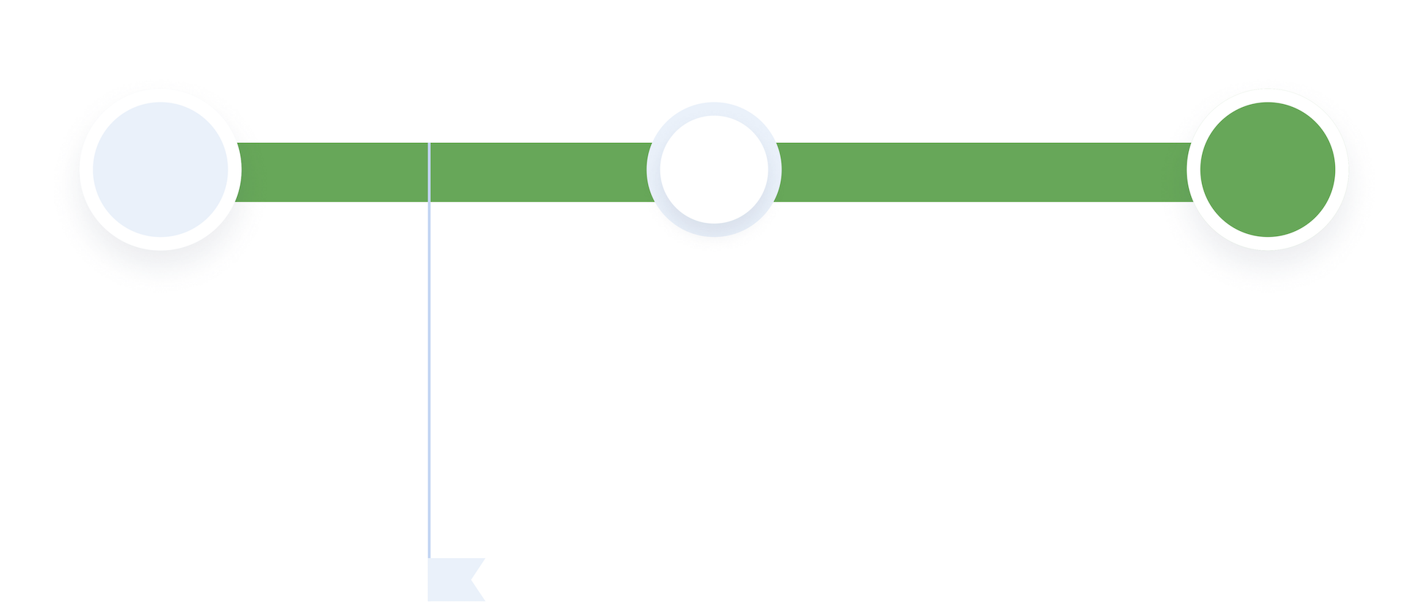
The Three Basic Steps
Step 1
Audio input from microphone (sensor)
Step 2
Process input translation, then execute command
Step 3
Generate Output
play response through embedded speaker
input
complete

Slide 12
Input
Step 1
Audio input
from microphone (sensor)
Step 2
Process input translation, then execute command
Step 3
Generate Output
play response through embedded speaker
input
complete
input
complete

Slide 13
Endpoints Have Sensors, Tons of Sensors
Motion Sensors
Gyroscope, radar, magnetometer, accelerator
Acoustic Sensors
Ultrasonic, Microphones, Geophones, Vibrometers
Environmental Sensors
Temperature, Humidity, Pressure, IR, etc.
Touchscreen Sensors
Capacitive, IR
Image Sensors
Thermal, Image
Biometric Sensors
Fingerprint, Heart rate, etc.
Force Sensors
Pressure, Strain
Rotation Sensors
Encoders
Notes:
Acoutsic, biometric, force
Back and forth between this slide

Slide 14
Endpoints Have Sensors, Tons of Sensors
Motion Sensors
Gyroscope, radar, magnetometer, accelerator
Acoustic Sensors
Ultrasonic, Microphones, Geophones, Vibrometers
Environmental Sensors
Temperature, Humidity, Pressure, IR, etc.
Touchscreen Sensors
Capacitive, IR
Image Sensors
Thermal, Image
Biometric Sensors
Fingerprint, Heart rate, etc.
Force Sensors
Pressure, Strain
Rotation Sensors
Encoders
Notes:
Acoutsic, biometric, force
Back and forth between this slide

Slide 15
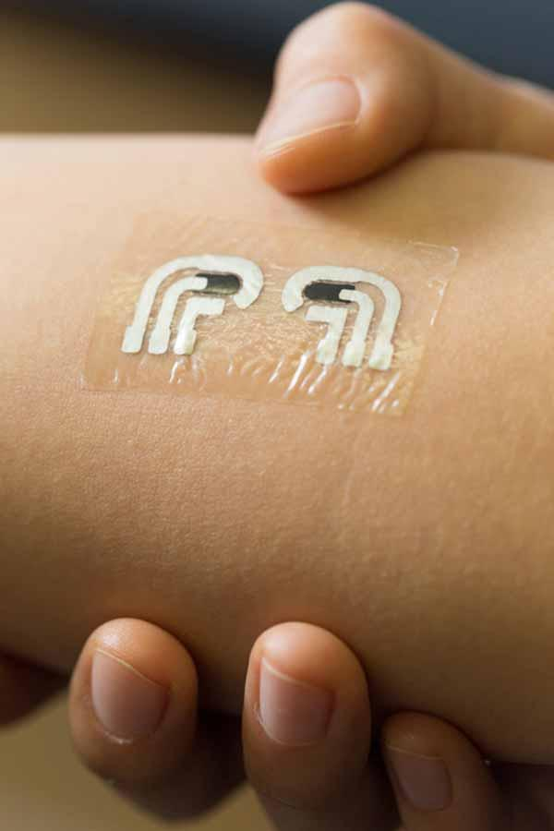
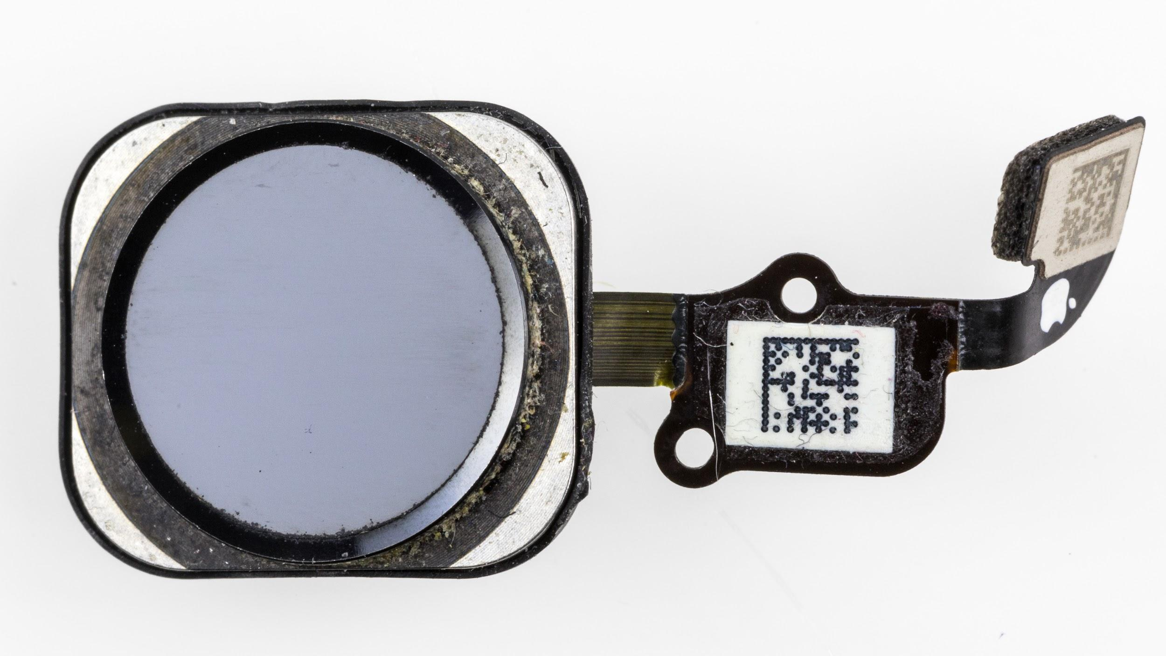
Biometric Sensors
Non-invasive Glucose Monitoring
Fingerprint + Photoplethysmography (PPG)
Source: Jacobs School of Engineering/UC San Diego
Notes:
Glucose monitors from Jacobs School
Electrocardiography is the process of producing an electrocardiogram. It is a graph of voltage versus time of the electrical activity of the heart using electrodes placed on the skin. Wikipedia
https://www.acs.org/content/acs/en/pressroom/presspacs/2015/acs-presspac-january-14-2015/tattoo-like-sensor-can-detect-glucose-levels-without-a-painful-finger-prick.html
https://commons.wikimedia.org/wiki/File:IPhone_6s_-_Touch_ID_front_view-93104.jpg

Slide 16
Endpoints Have Sensors, Tons of Sensors
Motion Sensors
Gyroscope, radar, magnetometer, accelerator
Acoustic Sensors
Ultrasonic, Microphones, Geophones, Vibrometers
Environmental Sensors
Temperature, Humidity, Pressure, IR, etc.
Touchscreen Sensors
Capacitive, IR
Image Sensors
Thermal, Image
Biometric Sensors
Fingerprint, Heart rate, etc.
Force Sensors
Pressure, Strain
Rotation Sensors
Encoders
Notes:
Acoutsic, biometric, force
Back and forth between this slide

Slide 17
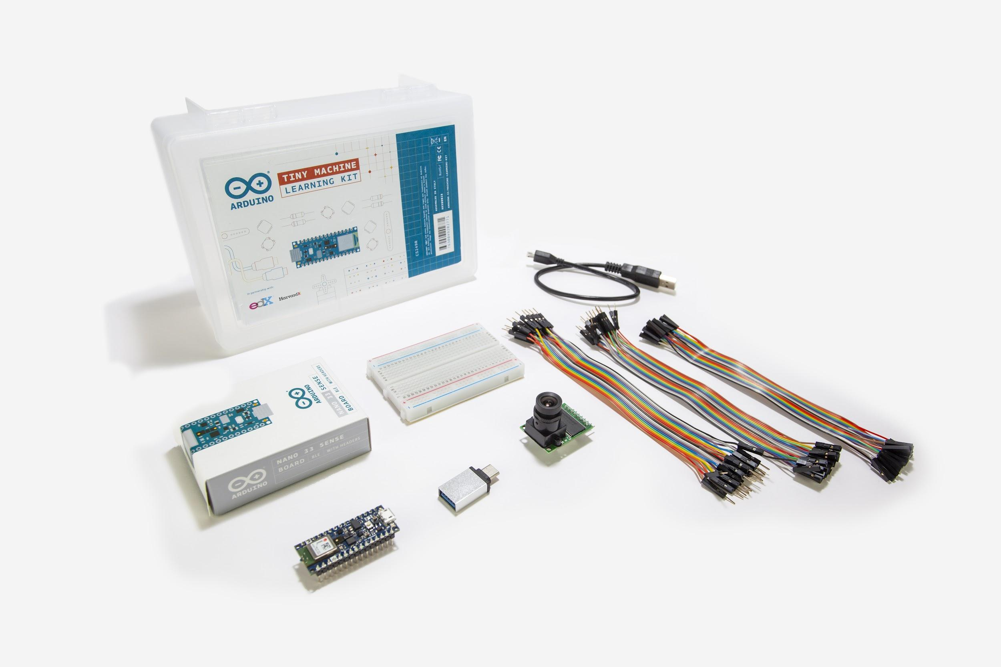
Endpoints Have Sensors, Tons of Sensors
Notes:
Acoutsic, biometric, force
Back and forth between this slide

Slide 18
Processing
Step 1
Audio input from microphone (sensor)
Step 2
Process input translation, then execute command
Step 3
Generate Output
play response through embedded speaker
input
complete

Slide 19
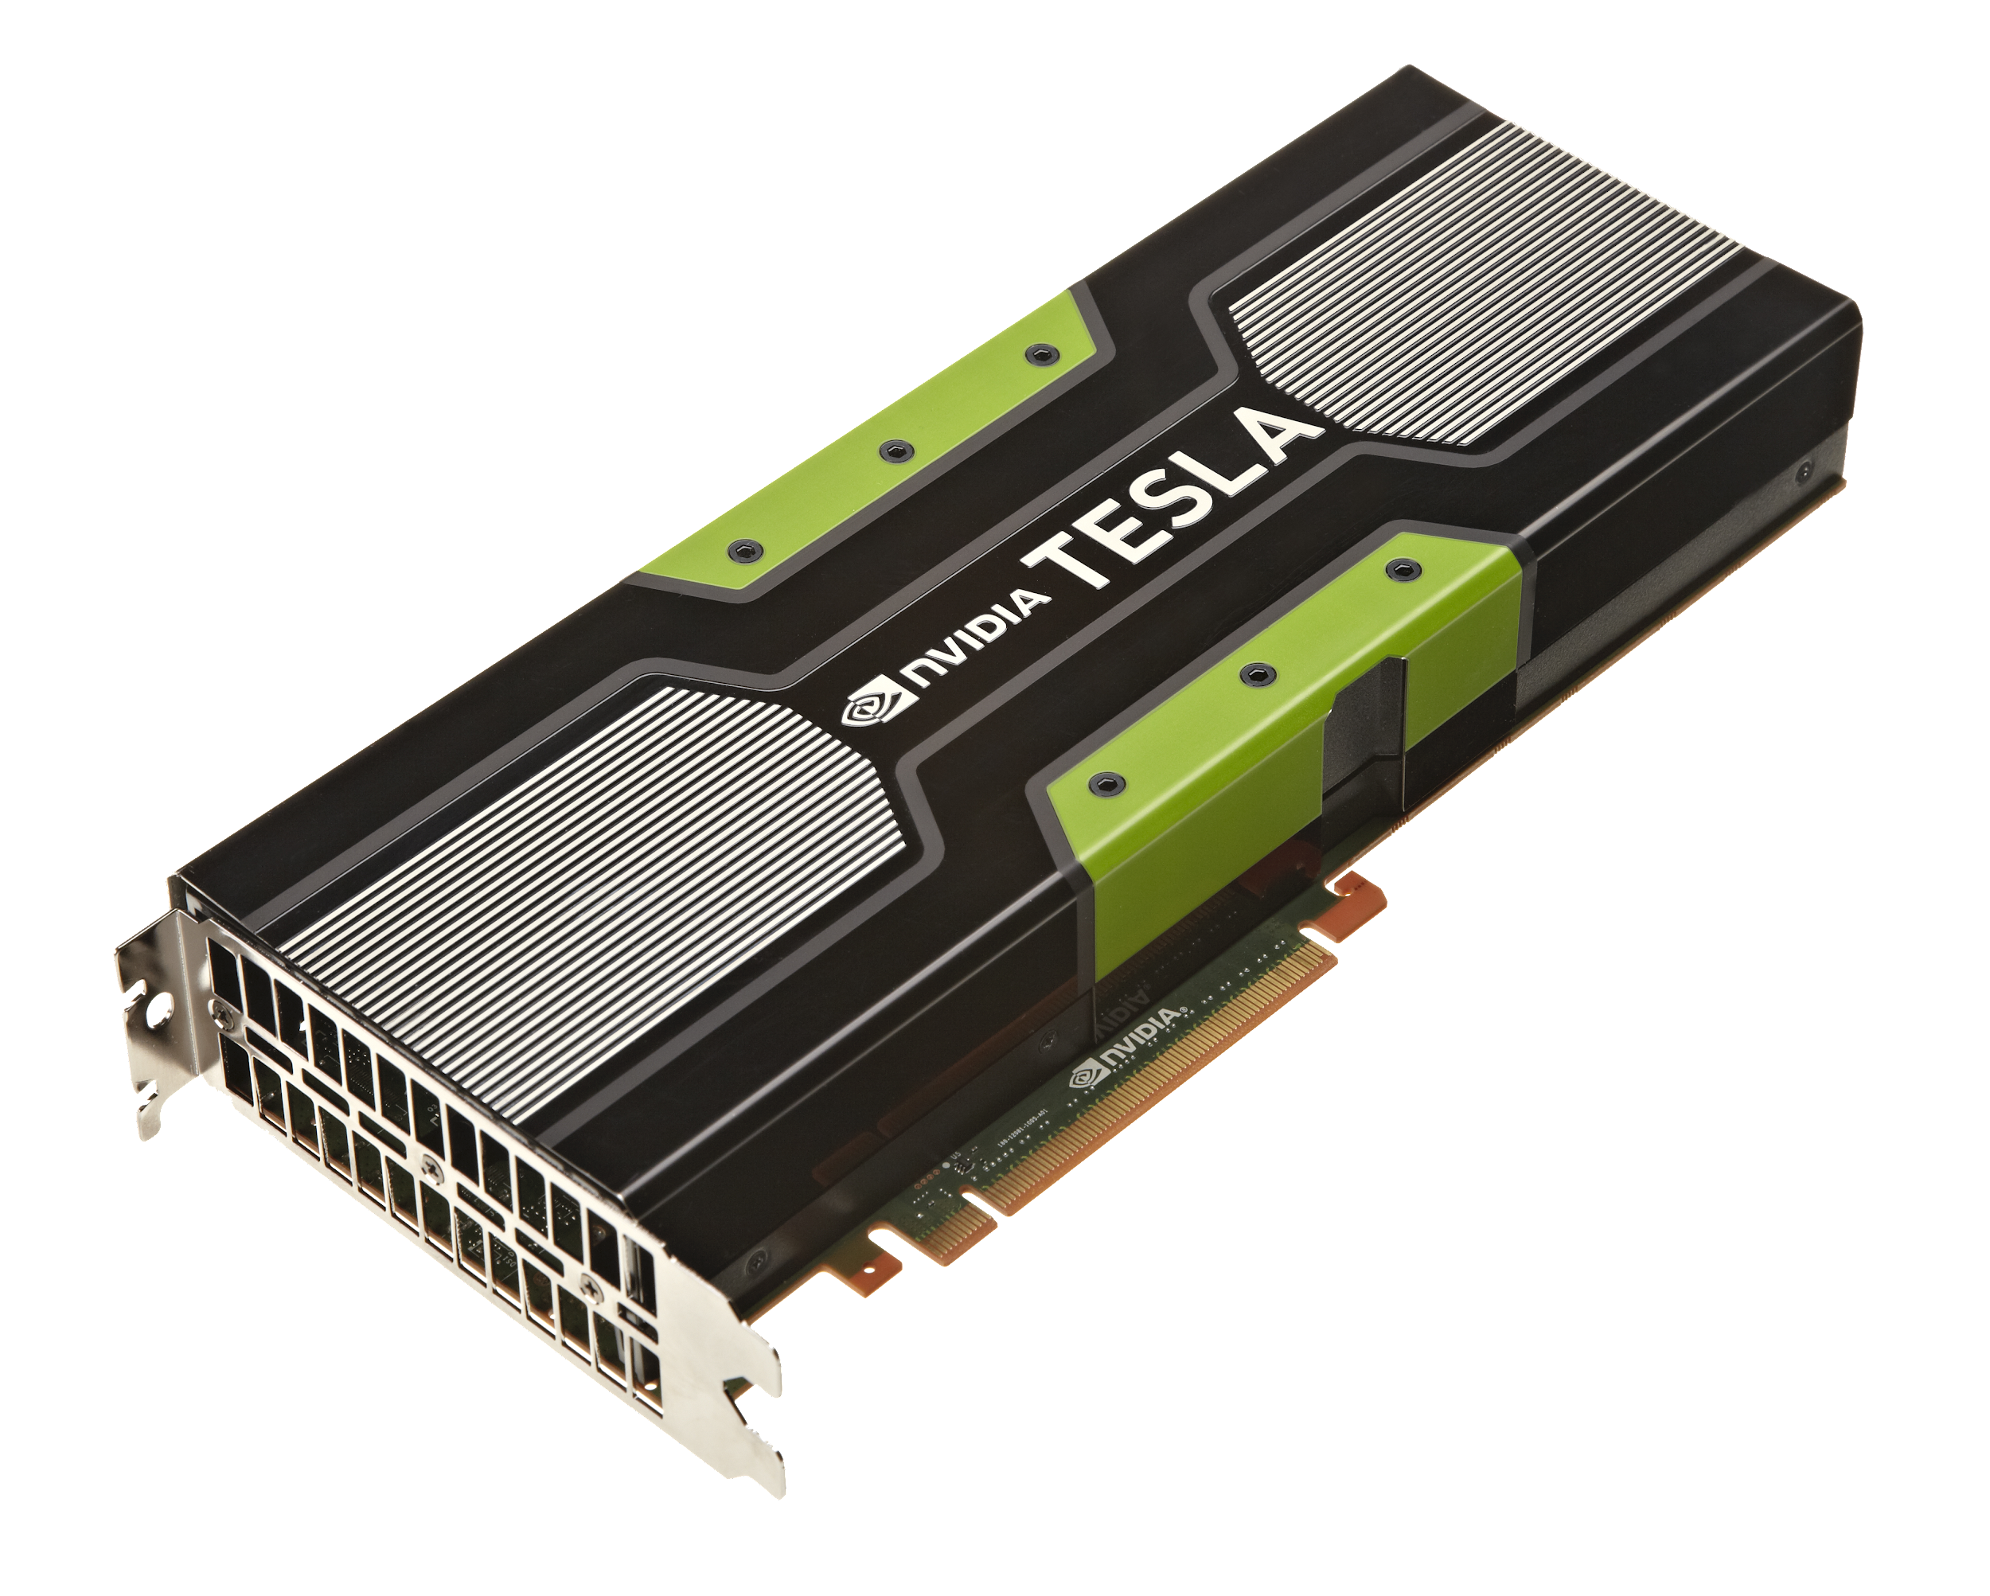
Thinking Big
Notes:
https://www.flickr.com/photos/130561288@N04/47923436641/in/photostream/
https://commons.wikimedia.org/wiki/File:IPhone_11_Pro_Max_Midnight_Green.svg

Slide 20
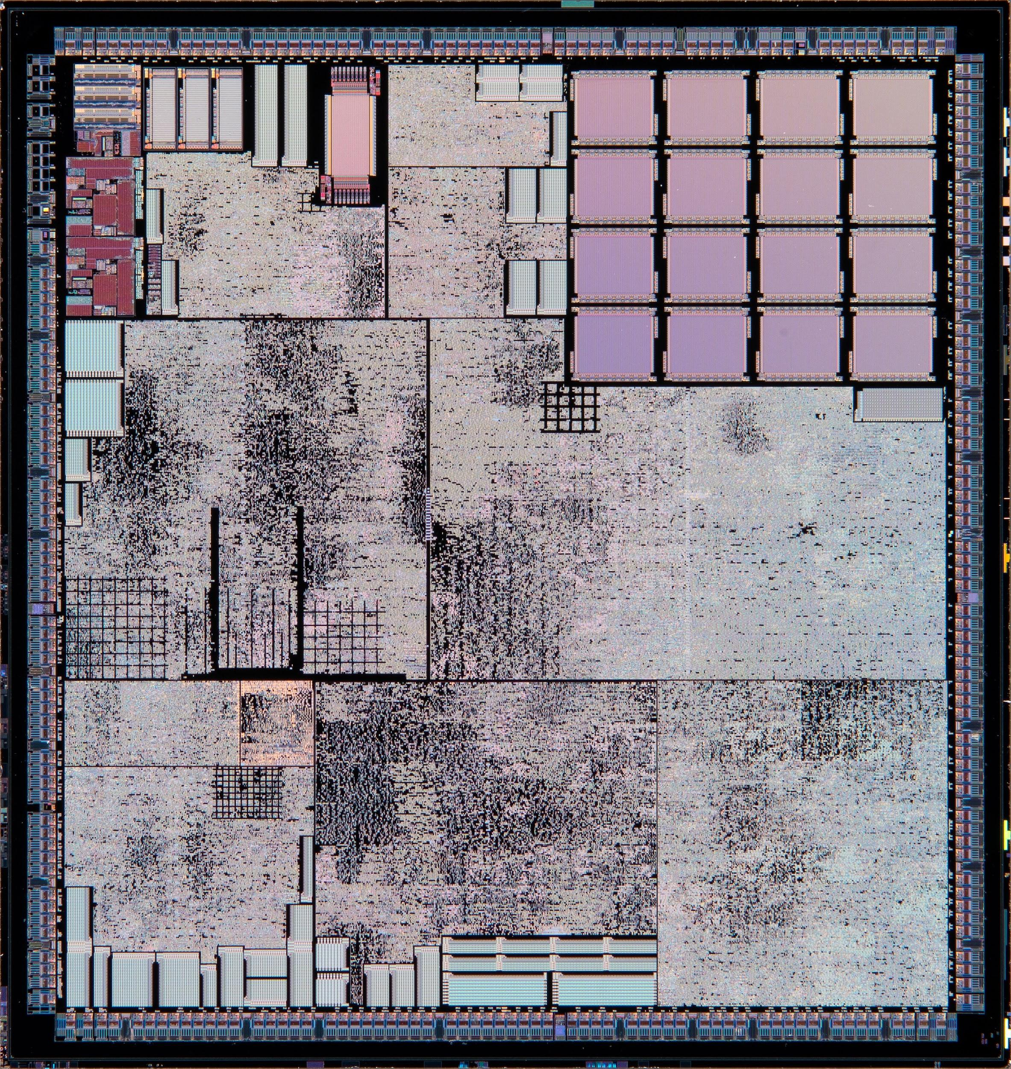
Thinking Big
Notes:
https://www.flickr.com/photos/130561288@N04/47923436641/in/photostream/
https://commons.wikimedia.org/wiki/File:IPhone_11_Pro_Max_Midnight_Green.svg

Slide 21
Thinking Big
BIG
GPU / CPU
561mm²
Notes:
https://www.flickr.com/photos/130561288@N04/47923436641/in/photostream/
https://commons.wikimedia.org/wiki/File:IPhone_11_Pro_Max_Midnight_Green.svg

Slide 22
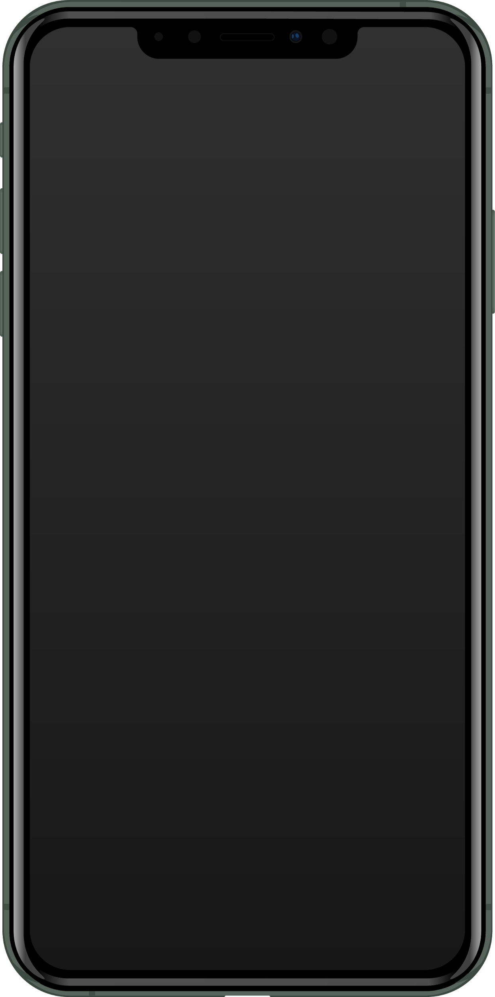
Thinking Small
BIG
GPU / CPU
561mm²
Notes:
https://www.flickr.com/photos/130561288@N04/47923436641/in/photostream/
https://commons.wikimedia.org/wiki/File:IPhone_11_Pro_Max_Midnight_Green.svg

Slide 23
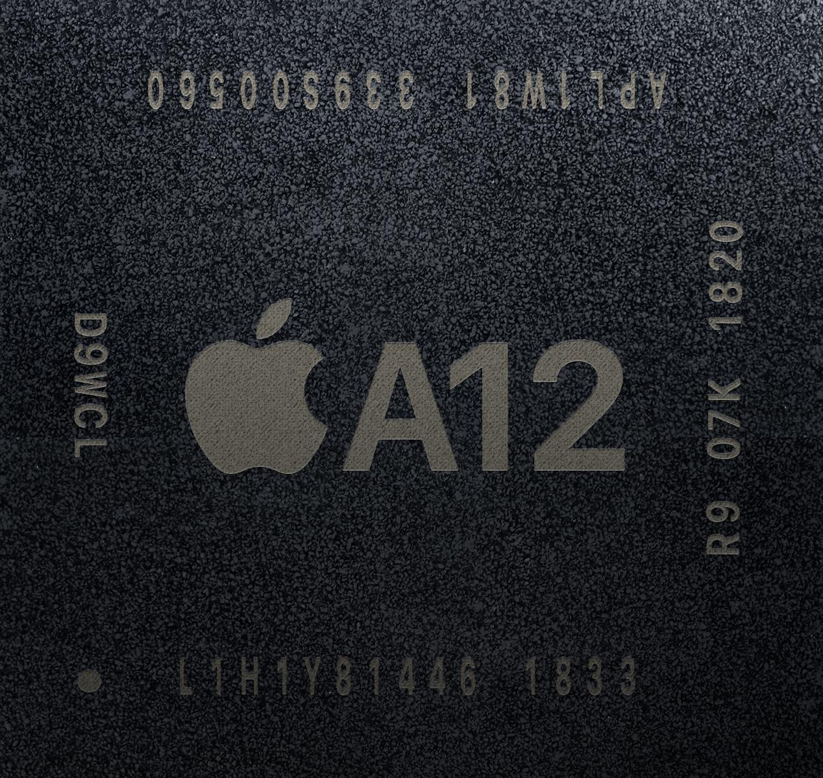
Thinking Small
BIG
GPU / CPU
561mm²
Notes:
https://www.flickr.com/photos/130561288@N04/47923436641/in/photostream/
https://commons.wikimedia.org/wiki/File:IPhone_11_Pro_Max_Midnight_Green.svg

Slide 24
Thinking Small
BIG
GPU / CPU
561mm²
SMALL
Mobile SoC
83mm²
Notes:
https://www.flickr.com/photos/130561288@N04/47923436641/in/photostream/
https://commons.wikimedia.org/wiki/File:IPhone_11_Pro_Max_Midnight_Green.svg

Slide 25
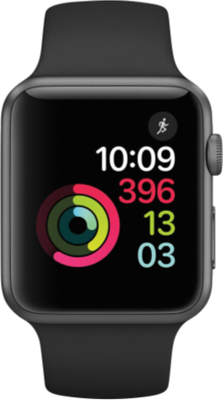
Thinking Tiny
BIG
GPU / CPU
561mm²
SMALL
Mobile SoC
83mm²
Notes:
https://www.flickr.com/photos/130561288@N04/47923436641/in/photostream/
https://commons.wikimedia.org/wiki/File:IPhone_11_Pro_Max_Midnight_Green.svg
https://commons.wikimedia.org/wiki/File:Apple-S1-in-watch.jpg
https://en.wikipedia.org/wiki/File:Apple-S1-chips.jpg
https://commons.wikimedia.org/wiki/File:Apple_Watch_(Space_Grey_42mm).png

Slide 26
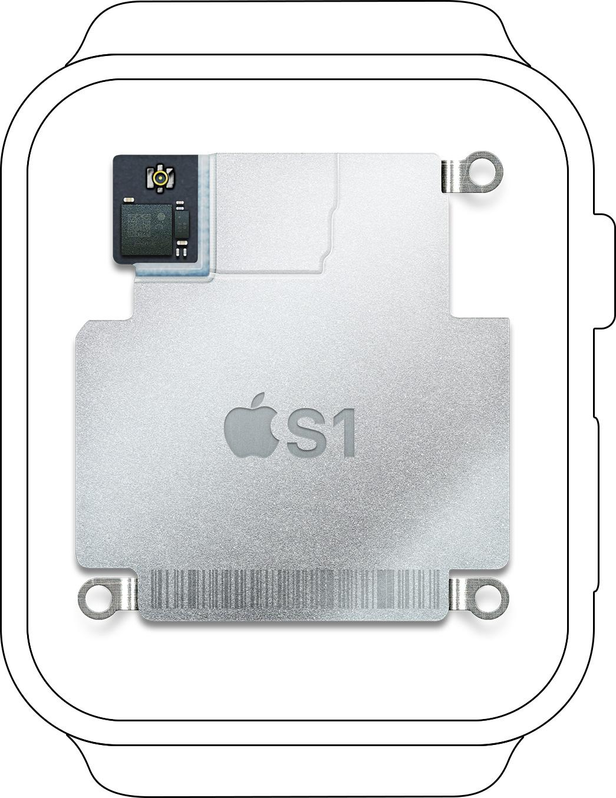
Thinking Tiny
BIG
GPU / CPU
561mm²
SMALL
Mobile SoC
83mm²
Notes:
https://www.flickr.com/photos/130561288@N04/47923436641/in/photostream/
https://commons.wikimedia.org/wiki/File:IPhone_11_Pro_Max_Midnight_Green.svg
https://commons.wikimedia.org/wiki/File:Apple-S1-in-watch.jpg
https://en.wikipedia.org/wiki/File:Apple-S1-chips.jpg
https://commons.wikimedia.org/wiki/File:Apple_Watch_(Space_Grey_42mm).png

Slide 27
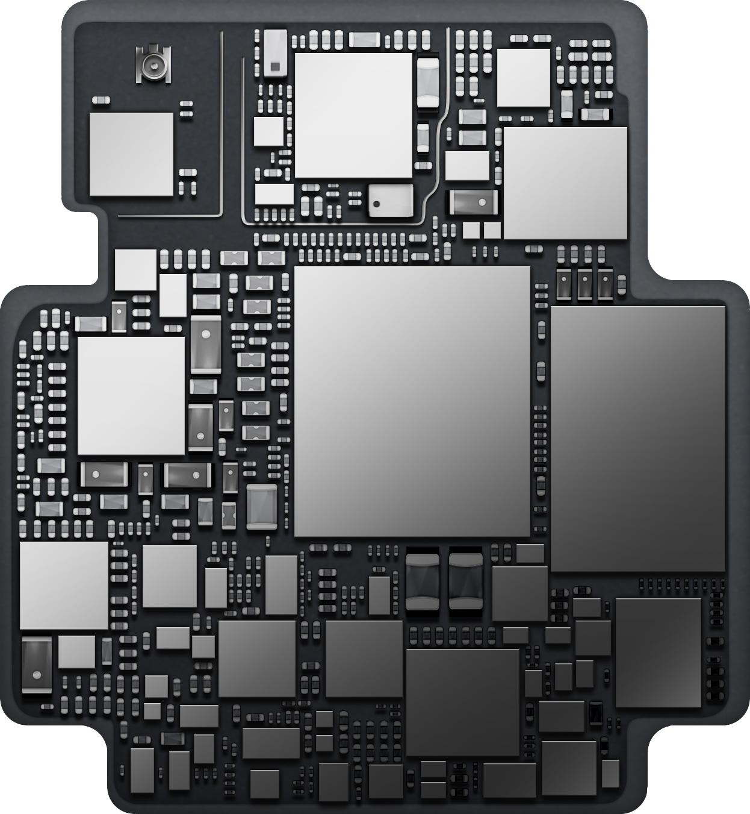
Thinking Tiny
BIG
GPU / CPU
561mm²
SMALL
Mobile SoC
83mm²
Notes:
https://www.flickr.com/photos/130561288@N04/47923436641/in/photostream/
https://commons.wikimedia.org/wiki/File:IPhone_11_Pro_Max_Midnight_Green.svg
https://commons.wikimedia.org/wiki/File:Apple-S1-in-watch.jpg
https://en.wikipedia.org/wiki/File:Apple-S1-chips.jpg
https://commons.wikimedia.org/wiki/File:Apple_Watch_(Space_Grey_42mm).png

Slide 28
Thinking Tiny
BIG
GPU / CPU
561mm²
SMALL
TINY
Apple 0778
30mm²
Mobile SoC
83mm²
Notes:
https://www.flickr.com/photos/130561288@N04/47923436641/in/photostream/
https://commons.wikimedia.org/wiki/File:IPhone_11_Pro_Max_Midnight_Green.svg
https://commons.wikimedia.org/wiki/File:Apple-S1-in-watch.jpg
https://en.wikipedia.org/wiki/File:Apple-S1-chips.jpg
https://commons.wikimedia.org/wiki/File:Apple_Watch_(Space_Grey_42mm).png

Slide 29
We’re just getting started.
Notes:
https://www.flickr.com/photos/130561288@N04/47923436641/in/photostream/
https://commons.wikimedia.org/wiki/File:IPhone_11_Pro_Max_Midnight_Green.svg
https://commons.wikimedia.org/wiki/File:Apple-S1-in-watch.jpg
https://en.wikipedia.org/wiki/File:Apple-S1-chips.jpg
https://commons.wikimedia.org/wiki/File:Apple_Watch_(Space_Grey_42mm).png

Slide 30
Thinking Record-breaking
BIG
GPU / CPU
561mm²
SMALL
TINY
Apple 0778
30mm²
Kinetis KL03
3.2mm²
Mobile SoC
83mm²
Notes:
https://www.flickr.com/photos/130561288@N04/47923436641/in/photostream/
https://commons.wikimedia.org/wiki/File:IPhone_11_Pro_Max_Midnight_Green.svg
https://commons.wikimedia.org/wiki/File:Apple-S1-in-watch.jpg
https://en.wikipedia.org/wiki/File:Apple-S1-chips.jpg
https://commons.wikimedia.org/wiki/File:Apple_Watch_(Space_Grey_42mm).png

Slide 31
Thinking Record-breaking
world’s smallest ARM-Powered MCU
48MHz, 32KB flash, 20-pin
BIG
GPU / CPU
561mm²
SMALL
TINY
Apple 0778
30mm²
Kinetis KL03
3.2mm²
Mobile SoC
83mm²
Notes:
https://www.flickr.com/photos/130561288@N04/47923436641/in/photostream/
https://commons.wikimedia.org/wiki/File:IPhone_11_Pro_Max_Midnight_Green.svg
https://commons.wikimedia.org/wiki/File:Apple-S1-in-watch.jpg
https://en.wikipedia.org/wiki/File:Apple-S1-chips.jpg
https://commons.wikimedia.org/wiki/File:Apple_Watch_(Space_Grey_42mm).png

Slide 32
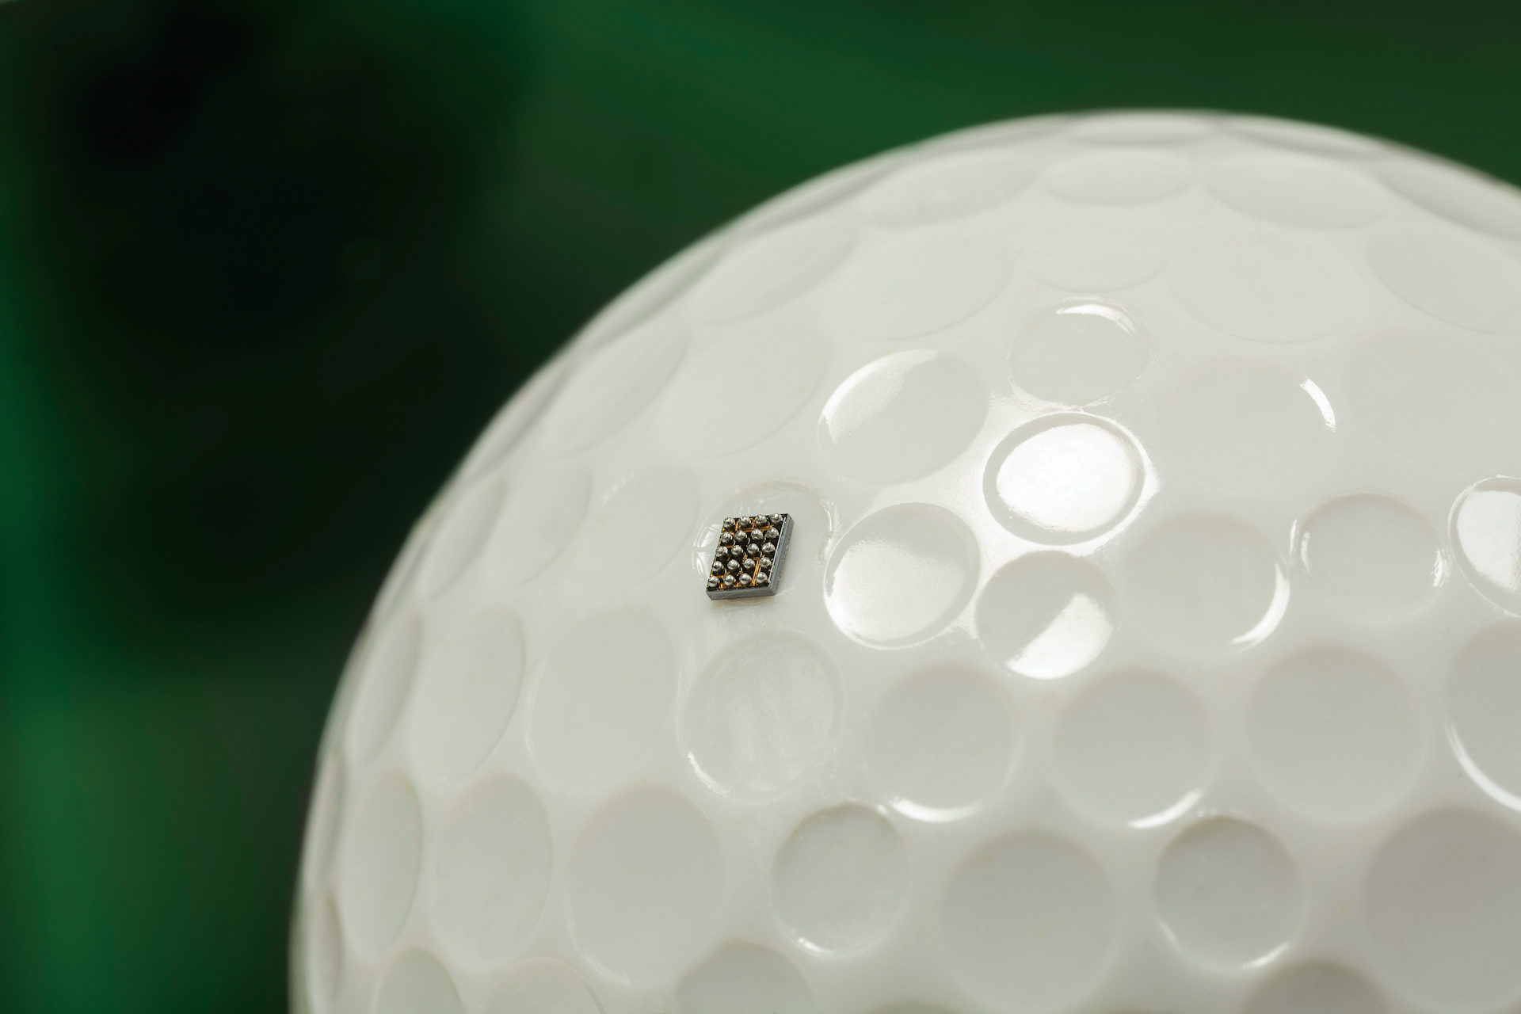
2.0 mm
1.6 mm
Notes:
Kinetis KL03 chip
https://www.businesswire.com/news/home/20140225005317/en/Freescale-Shrinks-World%E2%80%99s-Smallest-ARM-Based-MCU-Additional

Slide 33
250 Billion
MCUs today

Slide 34
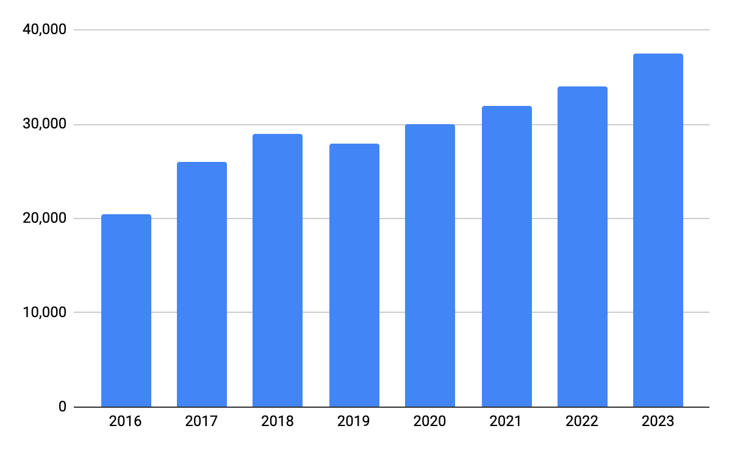
MCU Demand Forecast
Millions of Units
forecasted
Source: IC Insights

Slide 35
MCU Demand Forecast
Millions of Units
forecasted
Source: IC Insights

Slide 36
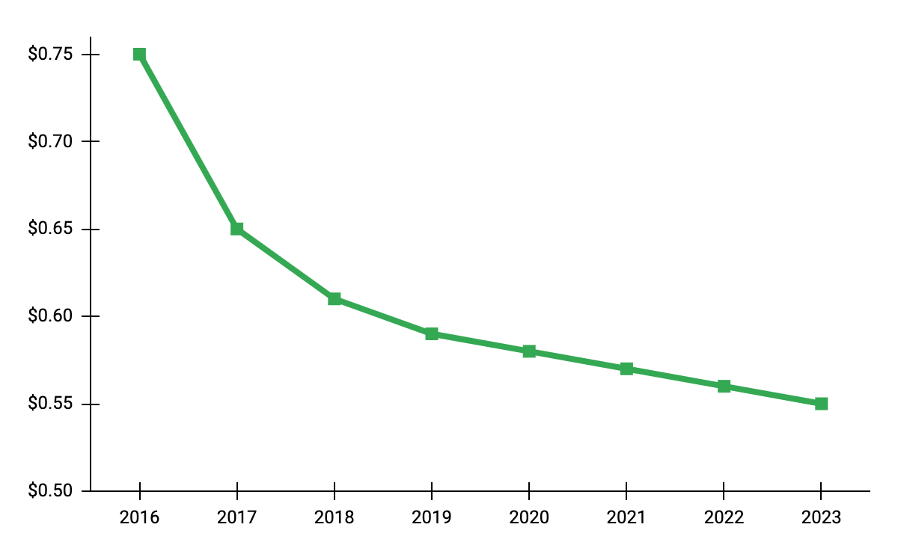
MCU Pricing Forecast
Average Selling Price
forecasted
Source: IC Insights

Slide 37
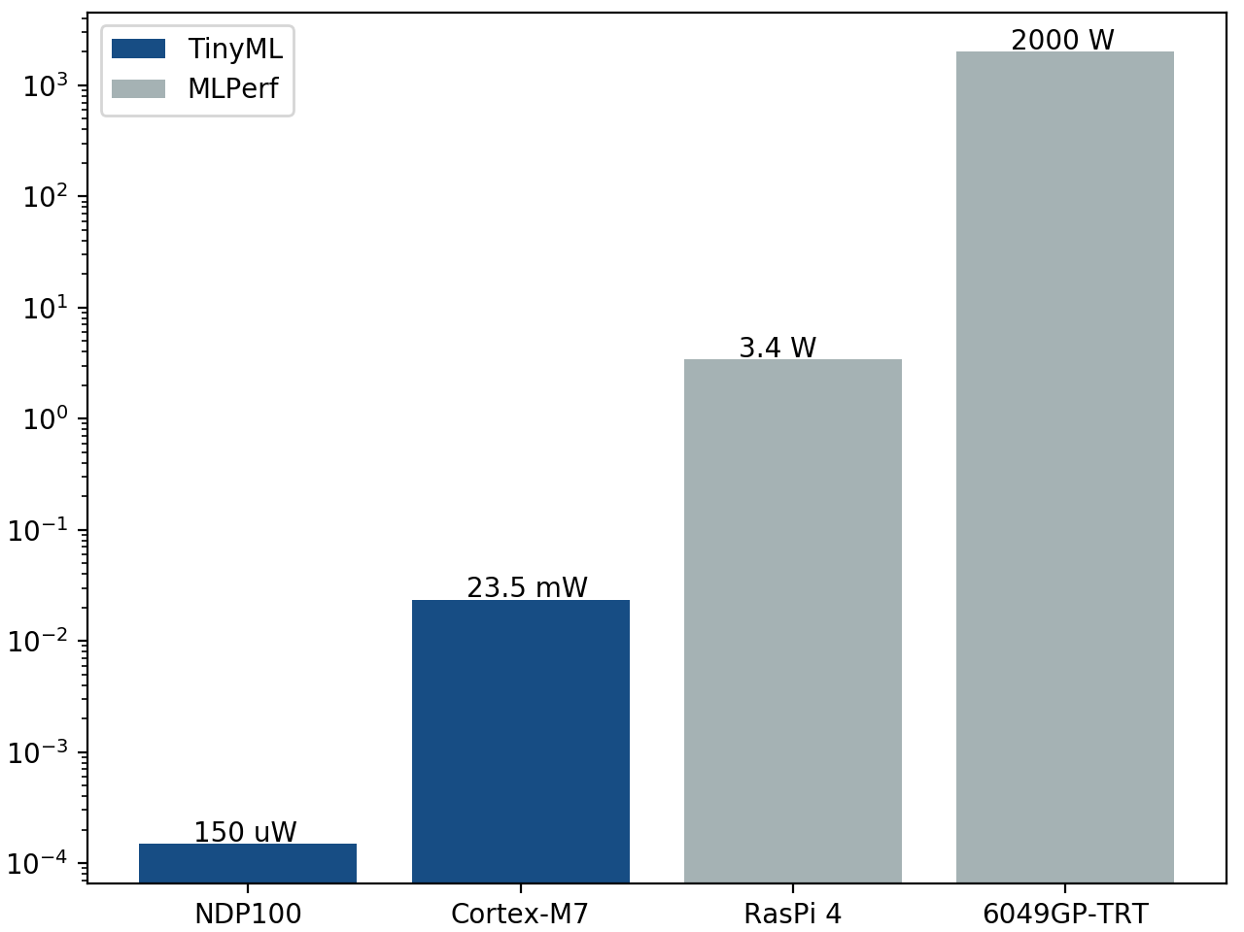
Comparing Power
BIG
GPU / CPU
SMALL
140 μW
Syntiant NDP100
3.64W
Apple A12
300W
NVIDIA Tesla K80

Slide 38
Comparing Power
BIG
GPU / CPU
SMALL
140 μW
Syntiant NDP100
3.64W
Apple A12
300W
NVIDIA Tesla K80

Slide 39
Comparing Power
Neural Decision Processor
Always-on deep learning
speech/audio recognition
Ultra low power, 128KB SRAM, 12-pin, 2.52mm²
BIG
GPU / CPU
SMALL
140 μW
Syntiant NDP100
3.64W
Apple A12
300W
NVIDIA Tesla K80

Slide 40
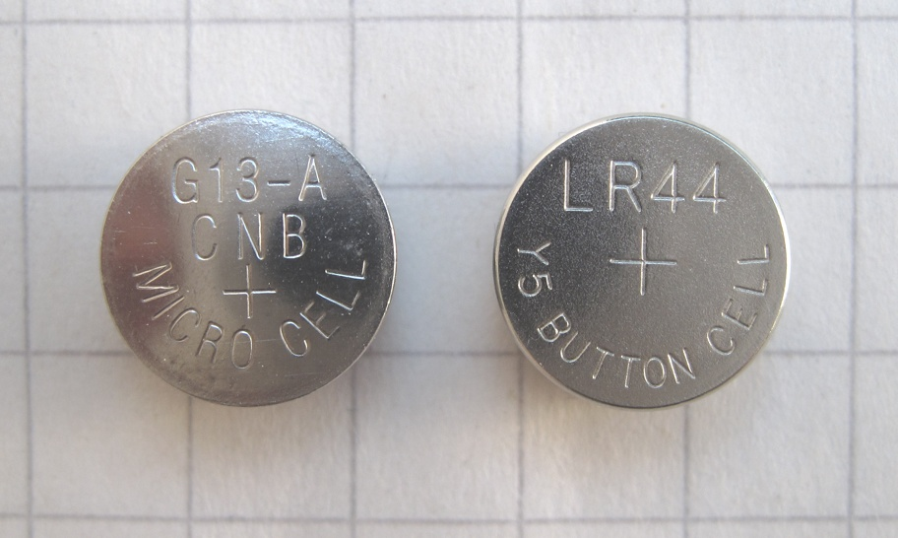
Comparing Power
Neural Decision Processor
Always-on deep learning
speech/audio recognition
Ultra low power, 128KB SRAM, 12-pin, 2.52mm²
140 μW
Syntiant NDP100
Use case: button cell battery
Notes:
https://commons.wikimedia.org/wiki/File:G13-A_LR44_button_cells-1.jpg

Slide 41
Output
Step 1
Audio input from microphone (sensor)
Step 2
Process input translation, then execute command
Step 3
Generate Output
play response through embedded speaker
input
complete

Slide 42
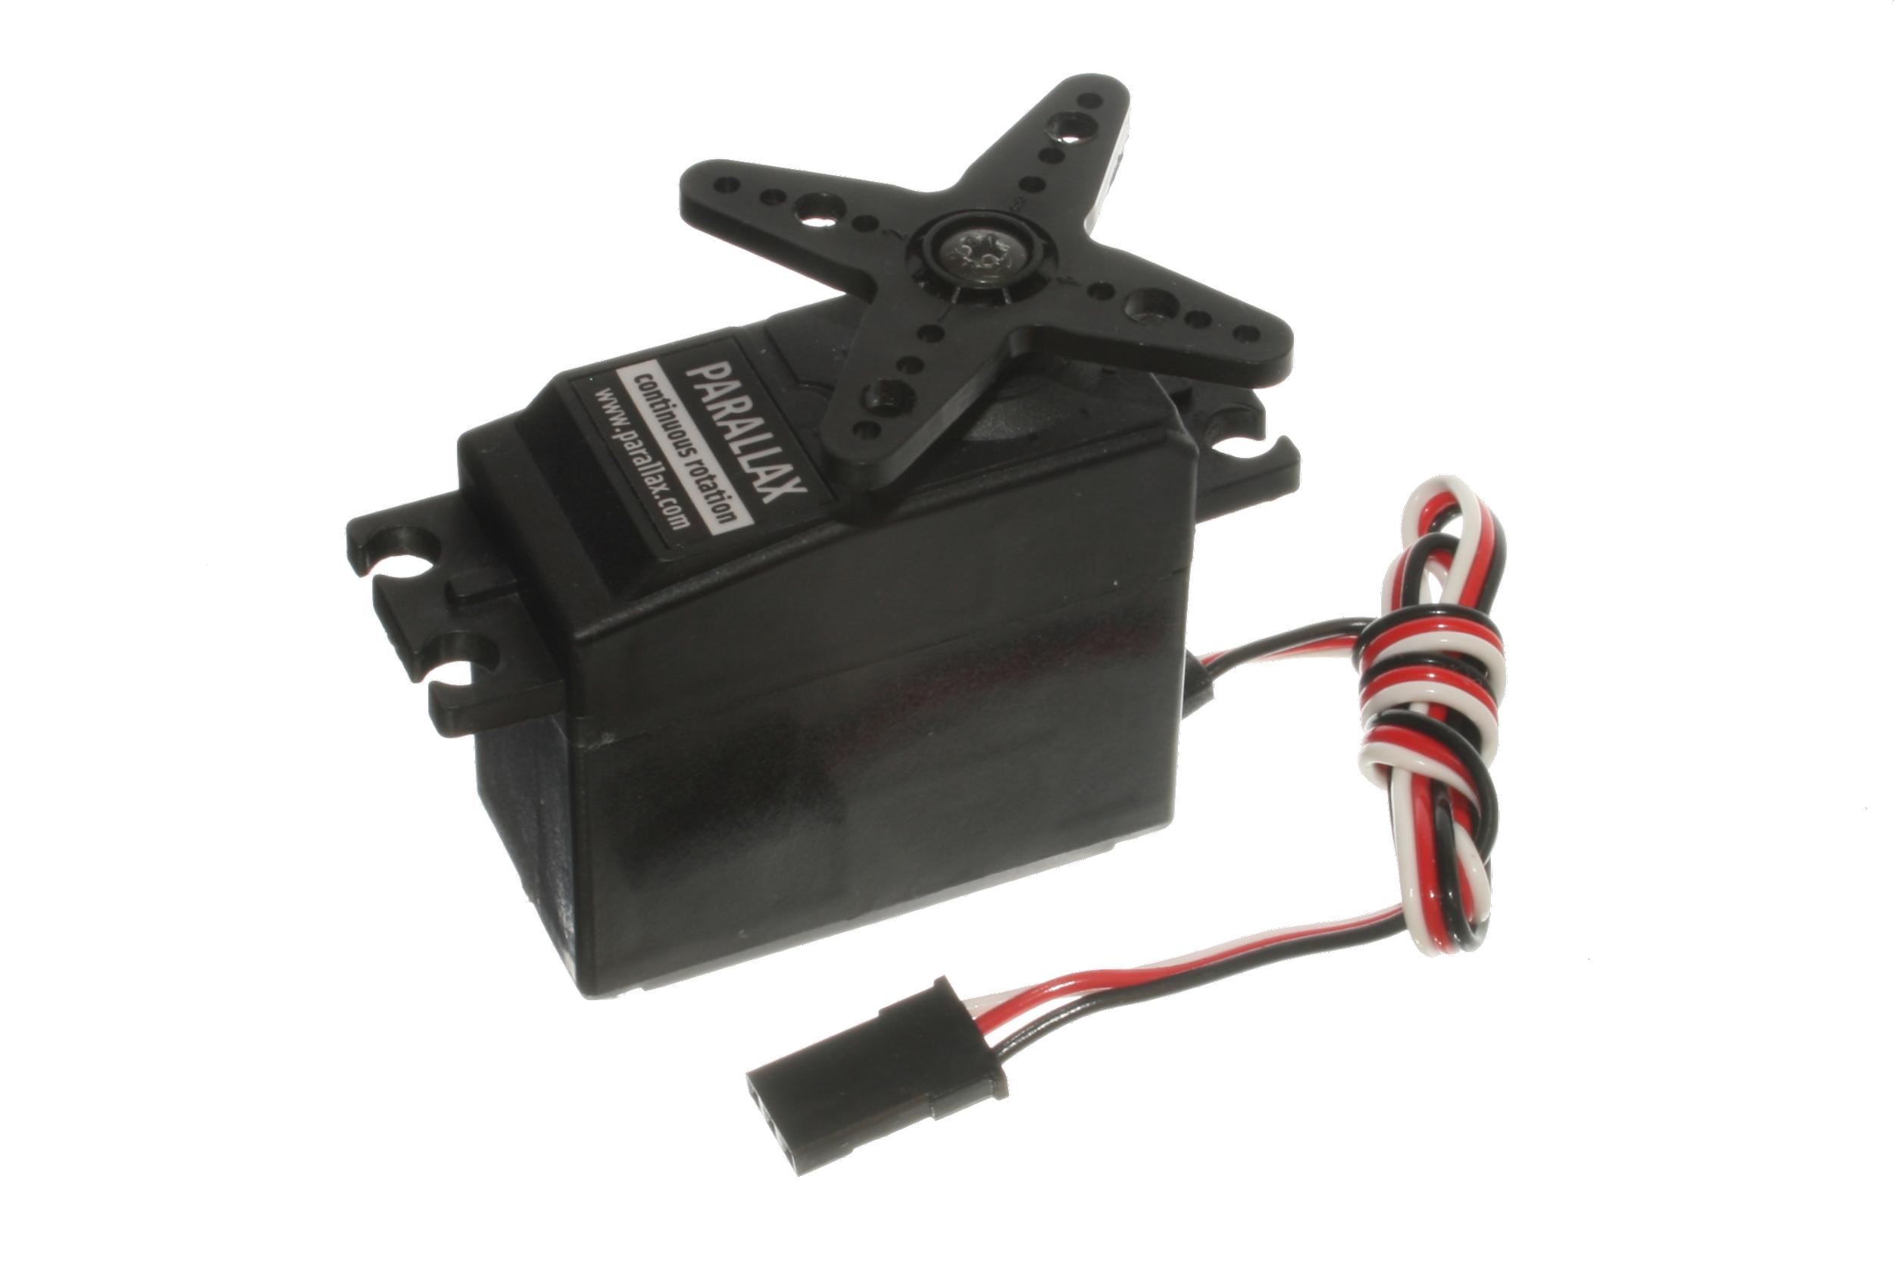
Output
Notes:
https://commons.wikimedia.org/wiki/File:PC-Speaker_IMG_8161.JPG
https://commons.wikimedia.org/wiki/File:Continuous_Rotation_Servo_(2).jpg

Slide 43
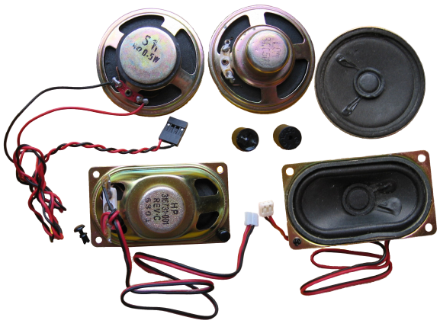
Output
Notes:
https://commons.wikimedia.org/wiki/File:PC-Speaker_IMG_8161.JPG
https://commons.wikimedia.org/wiki/File:Continuous_Rotation_Servo_(2).jpg

Slide 44
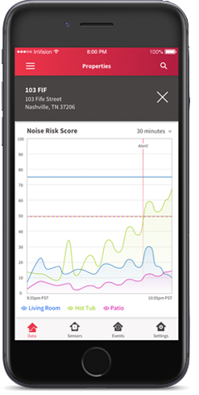
Output
Notes:
https://commons.wikimedia.org/wiki/File:PC-Speaker_IMG_8161.JPG
https://commons.wikimedia.org/wiki/File:Continuous_Rotation_Servo_(2).jpg
My graphic (phone) (Summer content dev 2019)

Slide 45
MCUs enable TinyML
SIZE
LOW POWER
LOW COST
Notes:
at this point, after going through the earlier slides, what do you two think would be the best way to tie up everything -- everything here being (1) tiny processors in devices ... (2) that are everywhere ... (3) that operate with ultra-low-power (even on coin cell batteries) ... (4) at low cost.
I feel this closing message here is super important so a nice illustration would be good. I can' tseem to think of one though. Maybe just a boring venn diagram (cost, power, form factor)?

Slide 46
MCUs enable TinyML
SIZE
LOW POWER
LOW COST
Notes:
at this point, after going through the earlier slides, what do you two think would be the best way to tie up everything -- everything here being (1) tiny processors in devices ... (2) that are everywhere ... (3) that operate with ultra-low-power (even on coin cell batteries) ... (4) at low cost.
I feel this closing message here is super important so a nice illustration would be good. I can' tseem to think of one though. Maybe just a boring venn diagram (cost, power, form factor)?

Slide 47
MCUs enable TinyML
SIZE
LOW POWER
LOW COST
< 140 μW
Syntiant NDP100
Notes:
at this point, after going through the earlier slides, what do you two think would be the best way to tie up everything -- everything here being (1) tiny processors in devices ... (2) that are everywhere ... (3) that operate with ultra-low-power (even on coin cell batteries) ... (4) at low cost.
I feel this closing message here is super important so a nice illustration would be good. I can' tseem to think of one though. Maybe just a boring venn diagram (cost, power, form factor)?

Slide 48
MCUs enable TinyML
SIZE
LOW POWER
LOW COST
Average Selling Price
Notes:
at this point, after going through the earlier slides, what do you two think would be the best way to tie up everything -- everything here being (1) tiny processors in devices ... (2) that are everywhere ... (3) that operate with ultra-low-power (even on coin cell batteries) ... (4) at low cost.
I feel this closing message here is super important so a nice illustration would be good. I can' tseem to think of one though. Maybe just a boring venn diagram (cost, power, form factor)?

Slide 49
MCUs enable TinyML
SIZE
LOW POWER
LOW COST
HIGH DEMAND

Slide 50

What Makes TinyML?
Embedded Systems
TinyML
Machine Learning
Notes:
https://thenounproject.com/term/merge/405869/

Slide 51
What Makes TinyML?
Embedded Systems
TinyML
Machine Learning

Slide 52
What Makes TinyML?
Embedded Systems
TinyML
Machine Learning

Slide 53
Fullscreen. Show presenter.

